Slide 1

Neural Networks Introduction @DETERMINED 2022 Workshop
Dr. U. Michelucci (TOELT)

Slide 2
Idea of NN
Advantages and disadvantages (black-box, explainability is difficult, etc.) of NN
Comparison biological neuron and artificial neuron
Composition of multiple simple units

Slide 3
Learning goals
The student can explain what is a neural network
The student understand what it means to “learn” for a neural network
The student can list the three most important components of a neural network
The student understand the main components of a neuron
The student understand how to frame a classification problem with neural networks
The student understand how gradient descent work in 1-dimension and what challenges exist for neural networks

Slide 4
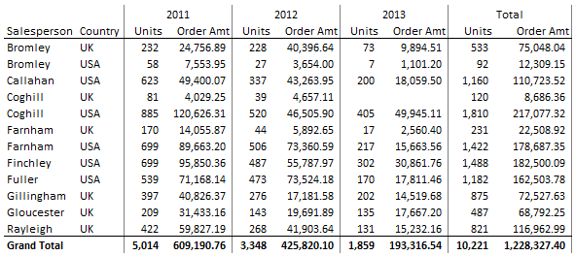
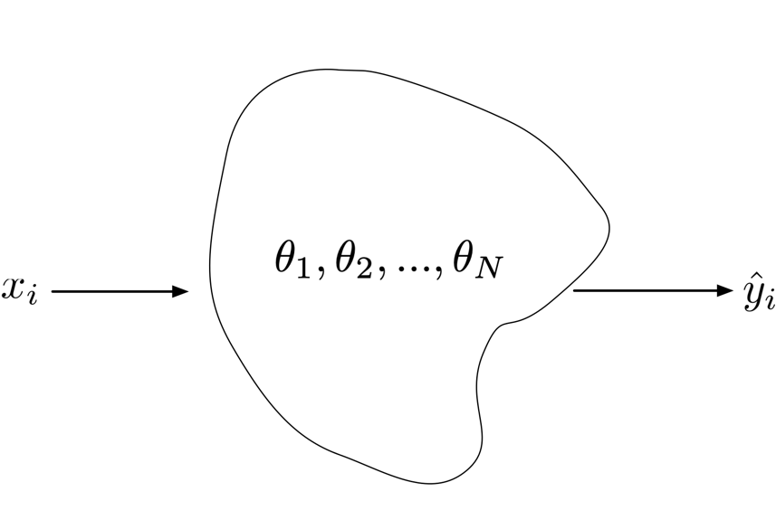
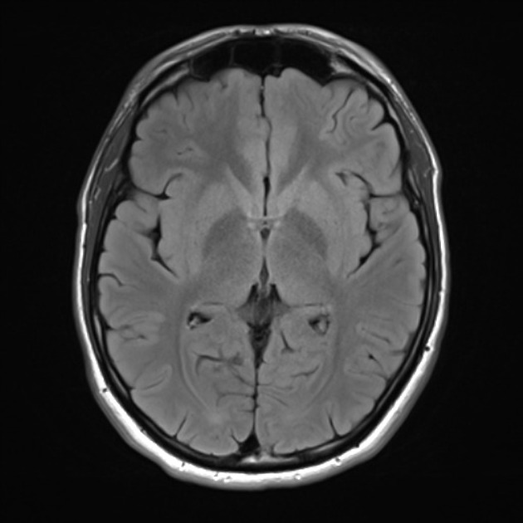
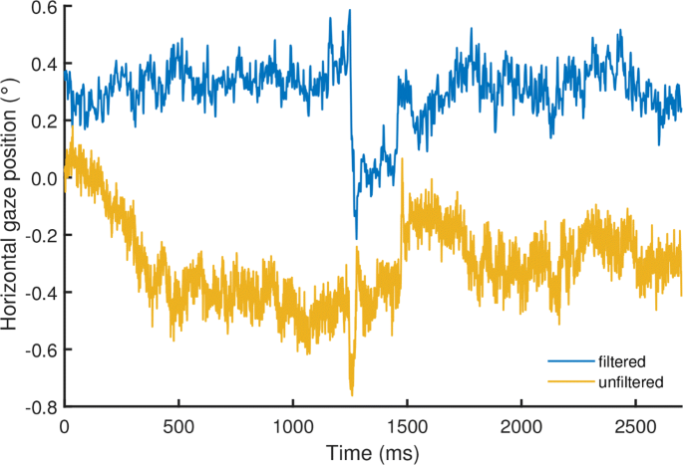
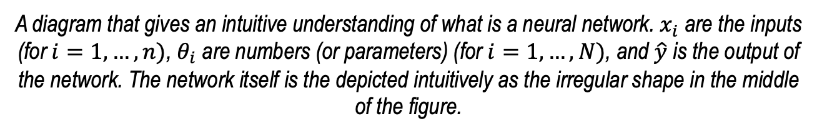
An intuitive understanding of a neural network
Class 1,
Class 2,
Class 3,
Etc.
Outputs
1.73
Inputs
A diagram that gives an intuitive understanding of what is a neural network. $x_{i}$ are the inputs (for $i=1,…,n)$, $θ_{i}$ are numbers (or parameters) (for $i=1,…,N)$, and $\hat{y}$ is the output of the network. The network itself is the depicted intuitively as the irregular shape in the middle of the figure.

Slide 5
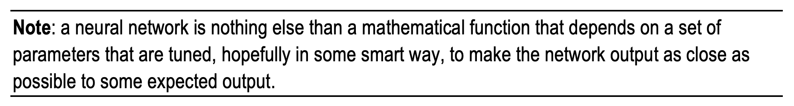
An intuitive definition of learning
What does it mean “as close as possible”?
We need a mathematical way of measuring “closeness”
U. Michelucci, Applied Deep Learning with TensorFlow 2, Springer Nature, 2022

Slide 6
An intuitive definition of learning
Loss Function
Optimiser
Neural Network Architecture
U. Michelucci, Applied Deep Learning with TensorFlow 2, Springer Nature, 2022

Slide 7
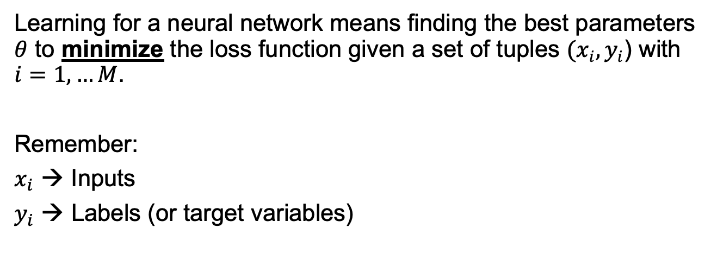
Learning in the context of neural networks
Learning for a neural network means finding the best parameters $θ$ to minimize the loss function given a set of tuples $(x_{i}, y_{i}$) with $i=1,…M$.
Remember:
$x_{i}$ → Inputs
$y_{i}$ → Labels (or target variables)
A mathematical formula
to measure “closeness”

Slide 8
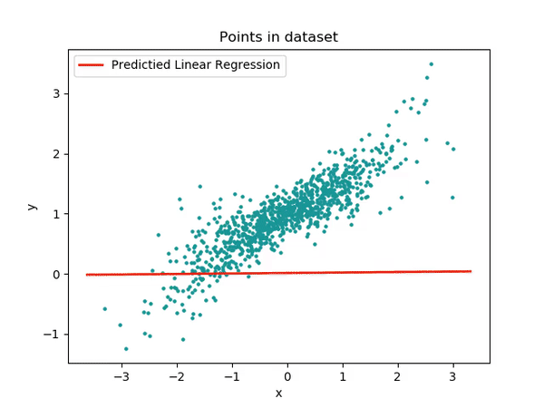
Example of learning
Image © Towarddatascience

Slide 9
The 3 main components of a neural network model
The neural network architecture (type of network, number of layers, etc.)
The loss function (the one we want to minimise)
The optimiser (the algorithm to find the minimum of the loss function)

Slide 10
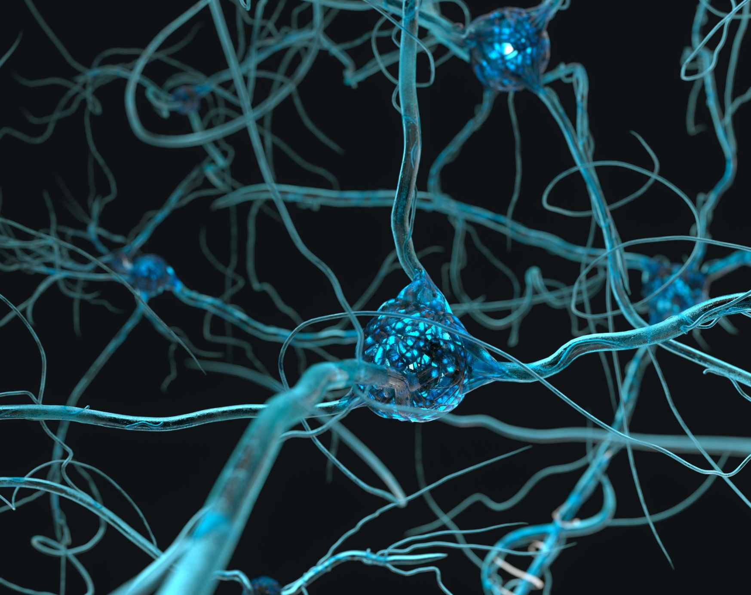
Structure of a neuron

Slide 11
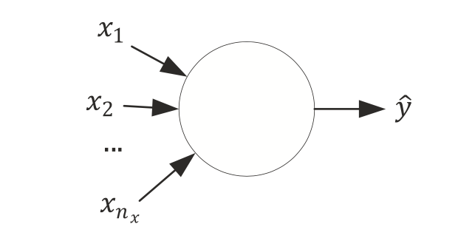
A neuron without details

Slide 12
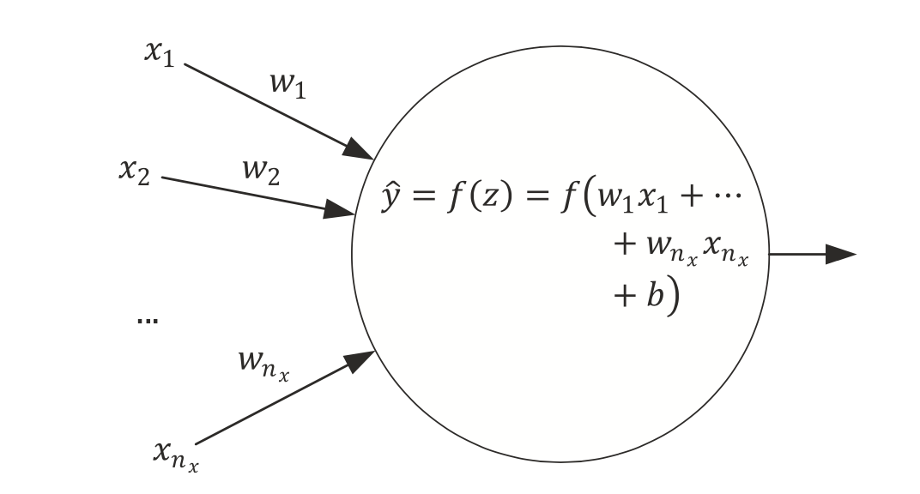
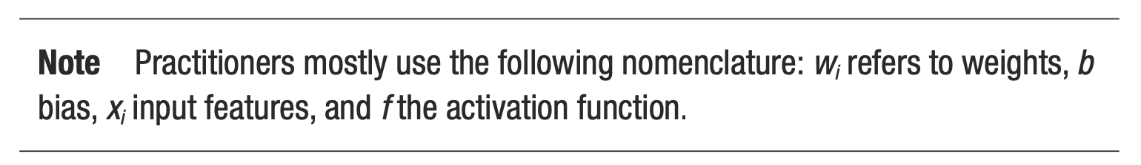
Simplest network possible
The simplest neural network that we can create is made of one single neuron.
Source:Umberto Michelucci, Applied Deep Learning - A Case-Based Approach to Understanding Deep Neural Networks, APRESS 2018

Slide 13
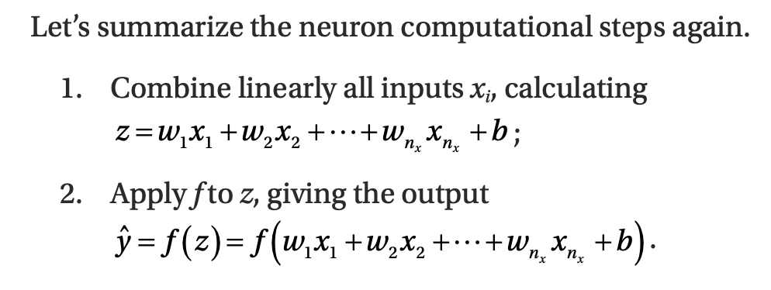
Computational Steps of a single neuron
Source:Umberto Michelucci, Applied Deep Learning - A Case-Based Approach to Understanding Deep Neural Networks, APRESS 2018

Slide 14
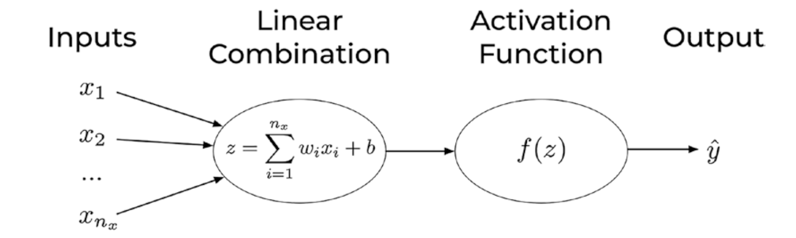
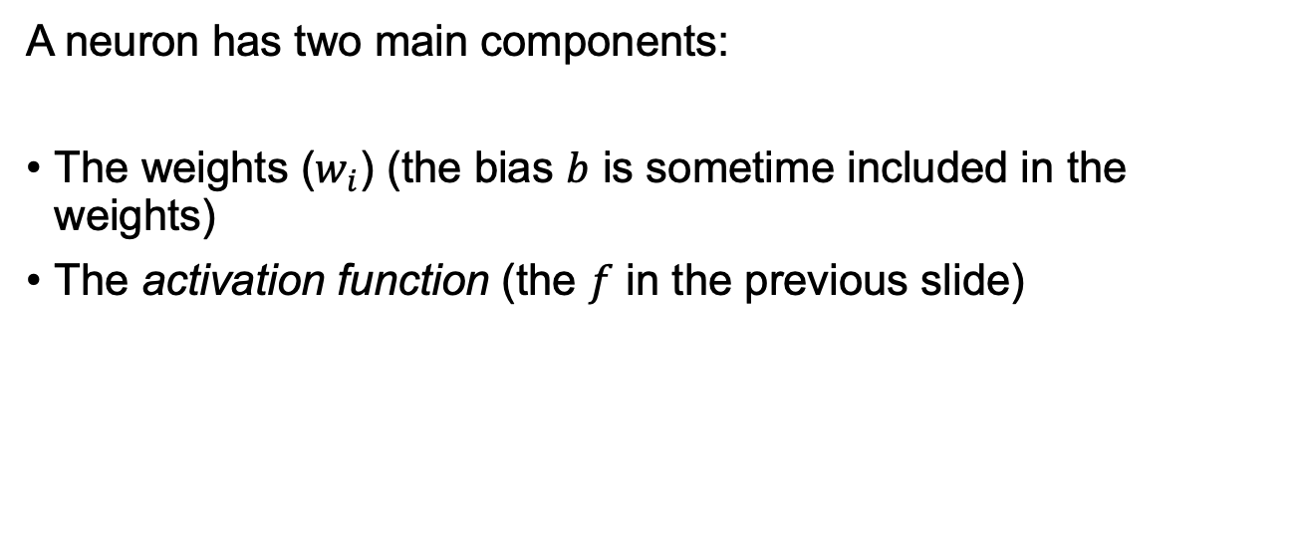
Components of a neuron
A neuron has two main components:
The weights ($w_{i}$) (the bias $b$ is sometime included in the weights)
The activation function (the $f$ in the previous slide)
U. Michelucci, Applied Deep Learning with TensorFlow 2, Springer Nature, 2022

Slide 15
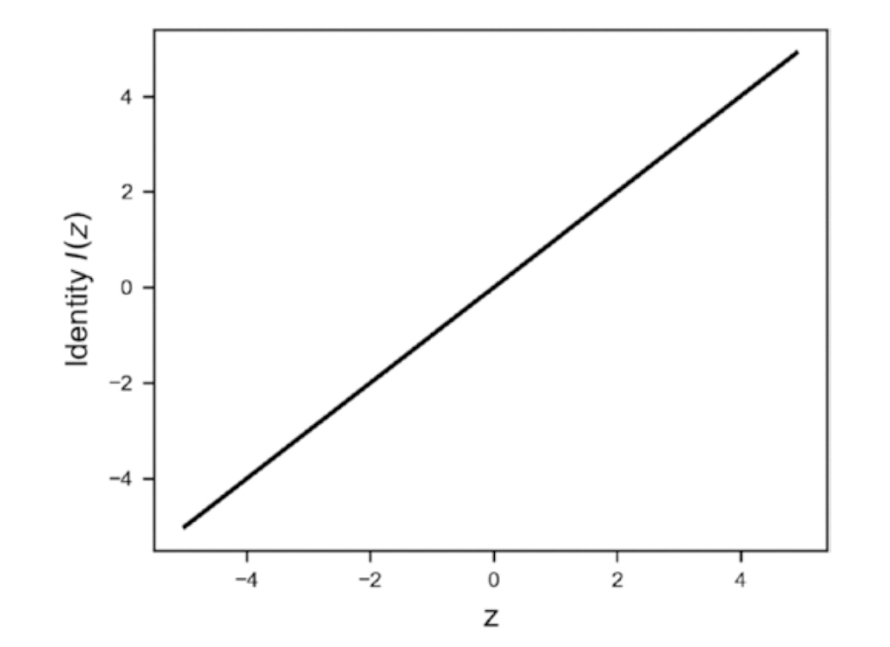
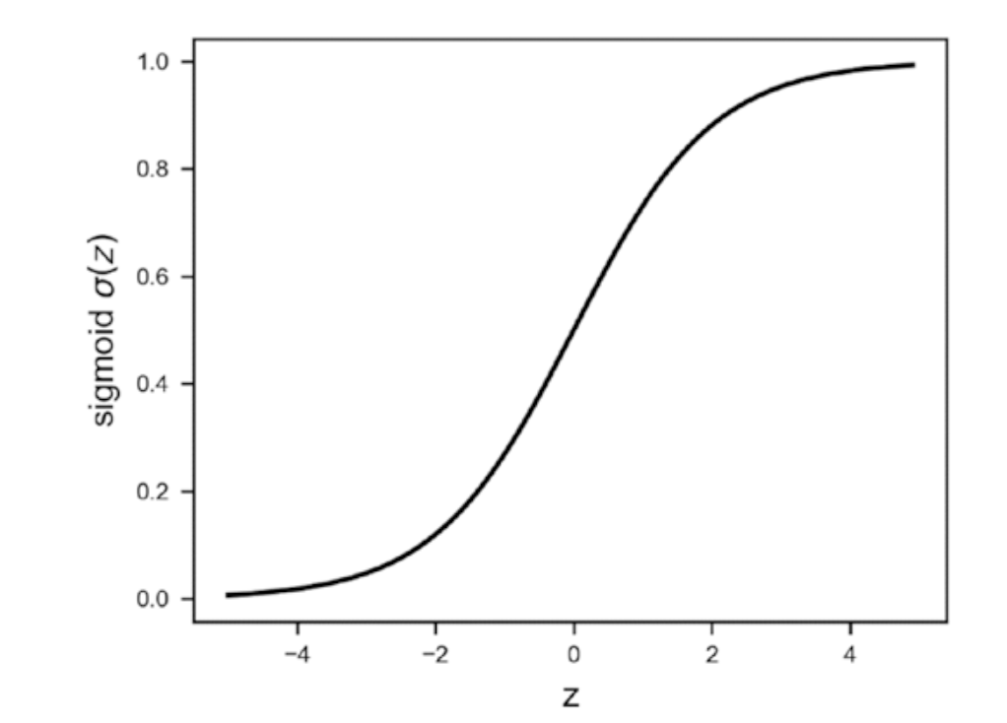
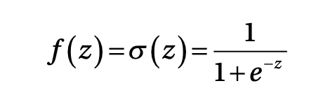
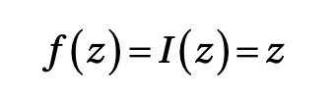
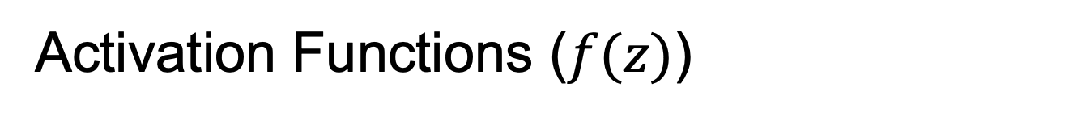
Activation Functions ($f(z)$)
Identity
Sigmoid

Slide 16
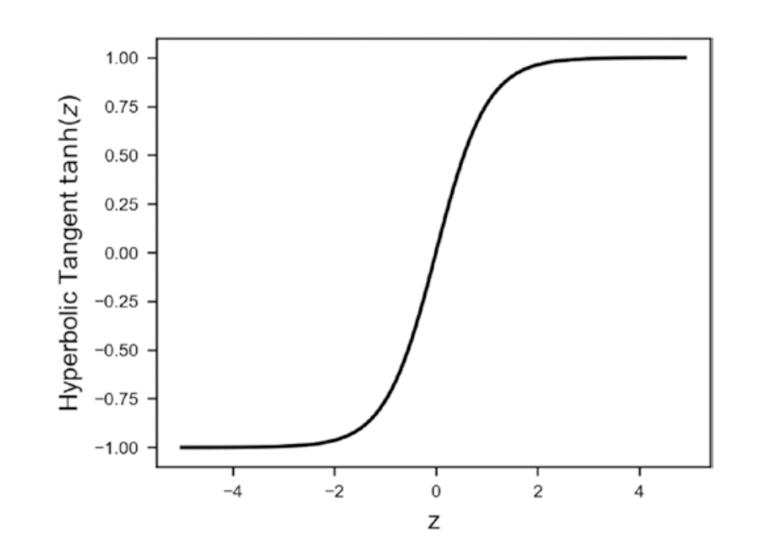
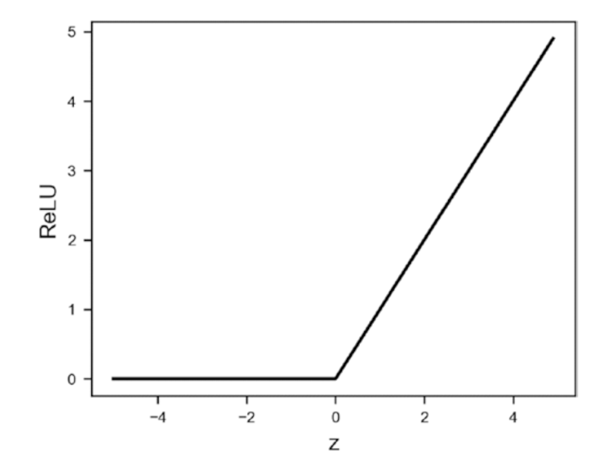
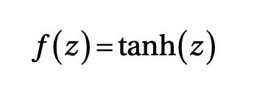
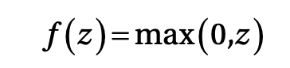
Activation Functions ($f(z)$)
Hyperbolic Tangent
ReLU (Rectified Linear Unit)

Slide 17
Activation Functions ($f(z)$)
Many others:
Leaky ReLU
Swish
ArcTan
Exponential Linear Unit (ELU)
Softplus

Slide 18
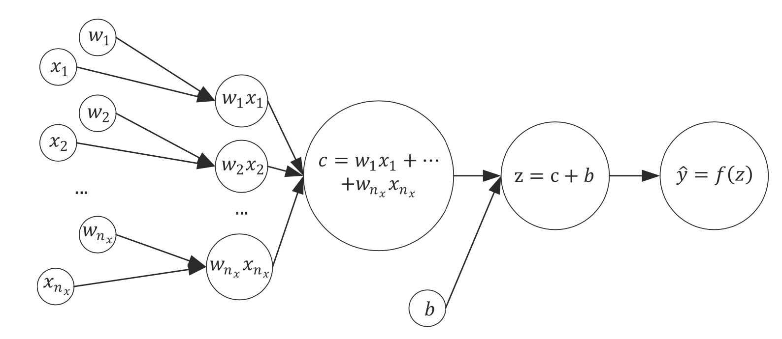
The same network seen as a computational graph
A computational graph is a directed graph where the nodes correspond to operations or variables. Variables can feed their value into operations, and operations can feed their output into other operations. This way, every node in the graph defines a function of the variables. (From: http://www.deepideas.net/deep-learning-from-scratch-i-computational-graphs/)
Source:Umberto Michelucci, Applied Deep Learning - A Case-Based Approach to Understanding Deep Neural Networks, APRESS 2018

Slide 19
What is a tensor (why TensorFlow?)
In its simplest (and somehow incorrect) definition a Tensor is simply a multi-dimensional array of numbers.
An image is a tensor of 3-dimensions (the horizontal and vertical resolution and the colors, RGB).

Slide 20
Learning for a neuron includes 3 steps
A neural network (defined by its architecture, in other words the computational steps to evaluate the network output)
A loss function (a function to measure how good or bad the network is predicting the outputs)
An algorithm to minimize the loss function (also called optimizer)
Source:Umberto Michelucci, Applied Deep Learning - A Case-Based Approach to Understanding Deep Neural Networks, APRESS 2018

Slide 21
What can a neuron do?
We have discussed how a neuron looks like. But how can a neuron solve any type of problem?
Can a neuron solve a classification and a regression problem? How can we do that?

Slide 22
Which portion of a neural network model is responsible for the type of problem that can be solved?
Two main components are responsible for the type of problem that can be solved:
The output activation function
The loss function
→ The optimiser is not related in any way to the type of problem solved.

Slide 23
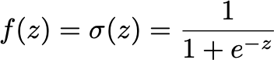
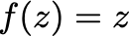
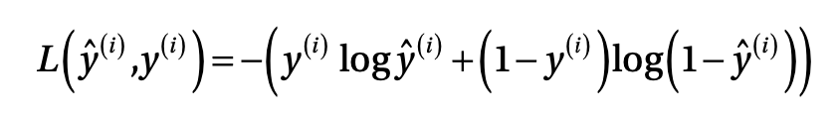
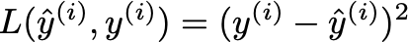
A single neuron can do a lot
Logistic regression
Linear regression

Slide 24
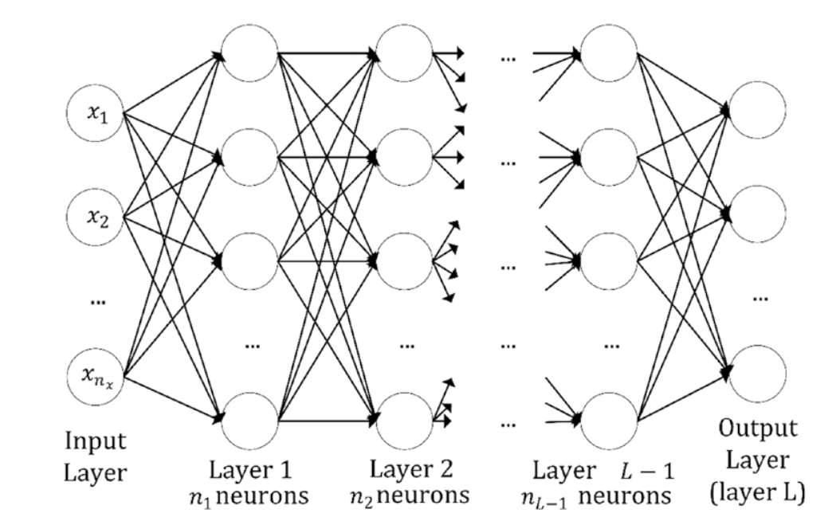
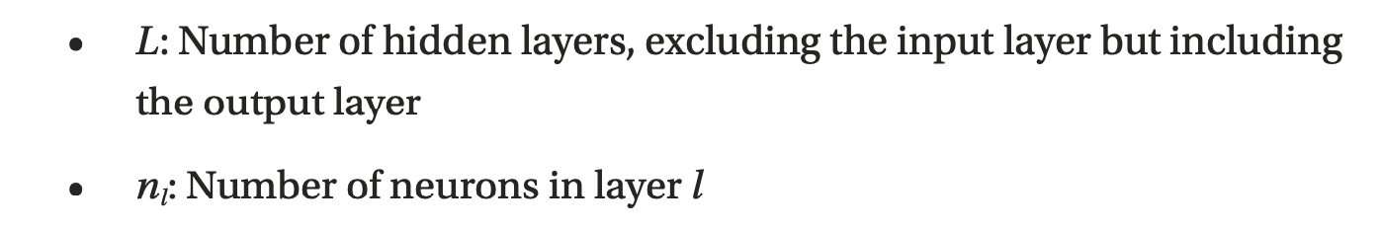
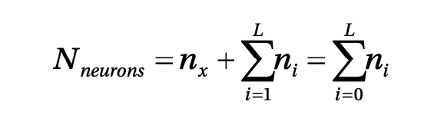
Multiple neurons / multiple layers
Source:Umberto Michelucci, Applied Deep Learning - A Case-Based Approach to Understanding Deep Neural Networks, APRESS 2018

Slide 25
How to do classification if the output is a real number?

Slide 26
Classification Problem and output activation function The Softmax function

Slide 27
Neural Network Architecture (example with 3 classes)
How should we interpret those numbers?
We would like to interpret them as the probability of the input observation to be in class 1, 2 or 3.
Network
Input

Slide 28
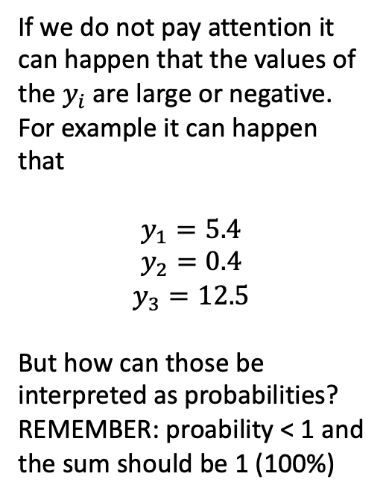
Neural Network Architecture (example with 3 classes)
If we do not pay attention it can happen that the values of the $y_{i}$ are large or negative. For example it can happen that
$$y_{1}=5.4$$
$$y_{2}=0.4$$
$$y_{3}=12.5$$
But how can those be interpreted as probabilities? REMEMBER: proability < 1 and the sum should be 1 (100%)
Network
Input

Slide 29
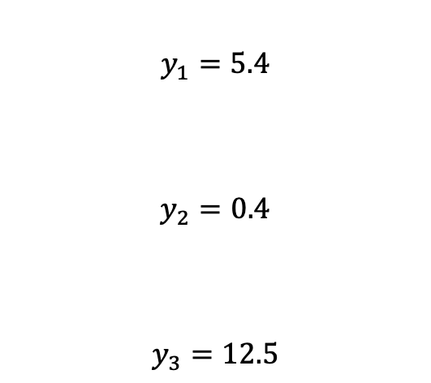
Neural Network Architecture (example with 3 classes)
$$y_{1}=5.4$$
$$y_{2}=0.4$$
$$y_{3}=12.5$$
Network
Input

Slide 30
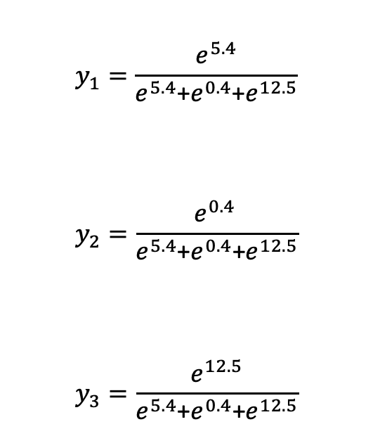
Neural Network Architecture (example with 3 classes)
$$y_{1}=\frac{e^{5.4}}{e^{5.4}\text{+}e^{0.4}\text{+}e^{12.5}}$$
$$y_{2}=\frac{e^{0.4 }}{e^{5.4}\text{+}e^{0.4}\text{+}e^{12.5}}$$
$$y_{3}=\frac{e^{12.5}}{e^{5.4}\text{+}e^{0.4}\text{+}e^{12.5}}$$
Network
Input

Slide 31

Neural Network Architecture (example with 3 classes)
$$y_{1}=\frac{e^{5.4}}{e^{5.4}\text{+}e^{0.4}\text{+}e^{12.5}}$$
$$y_{2}=\frac{e^{0.4 }}{e^{5.4}\text{+}e^{0.4}\text{+}e^{12.5}}$$
$$y_{3}=\frac{e^{12.5}}{e^{5.4}\text{+}e^{0.4}\text{+}e^{12.5}}$$
Network
Input
$${y_{1}+y}_{2}+y_{3}=1$$

Slide 32
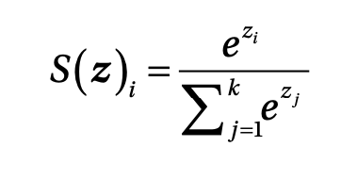
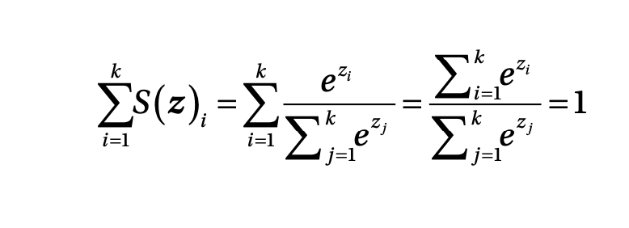
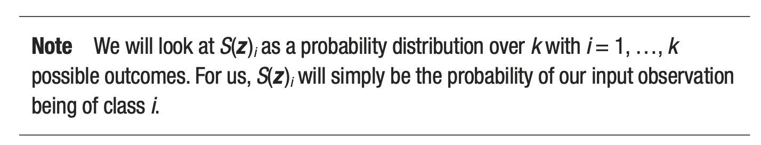
Softmax output layer for classification
Output of ith neuron of the output layer
Note that they can be interpreted as probability since the sum is equal to 1
Source:Umberto Michelucci, Applied Deep Learning - A Case-Based Approach to Understanding Deep Neural Networks, APRESS 2018

Slide 33
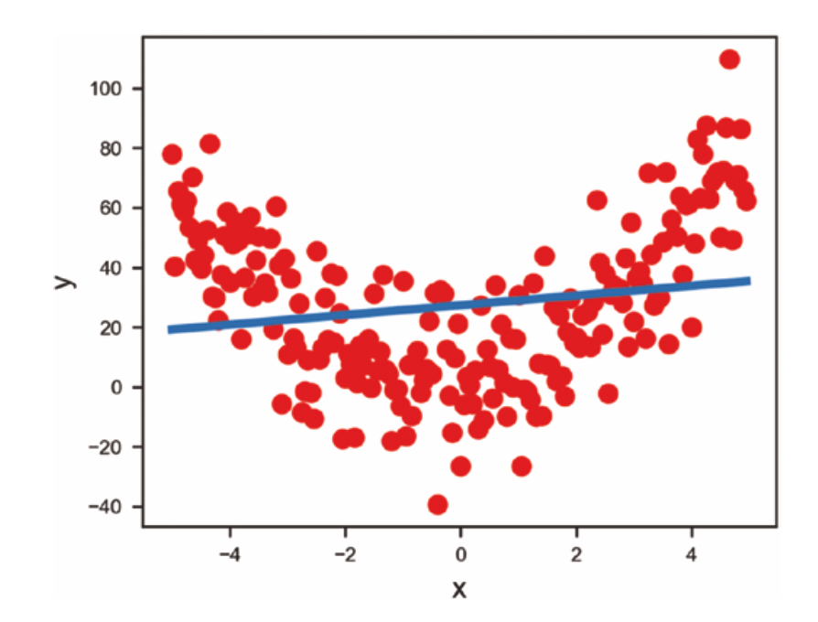
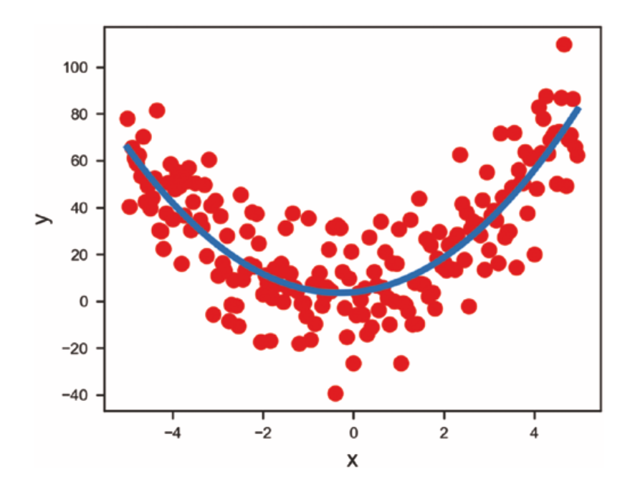
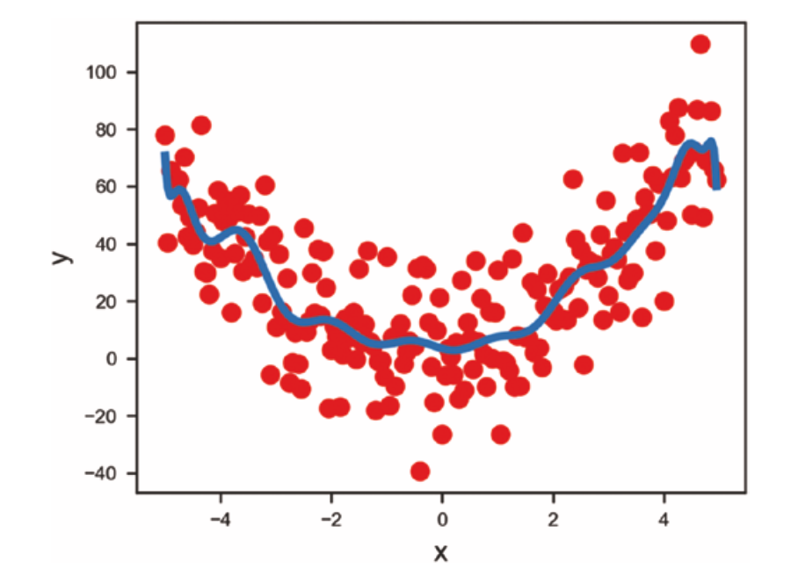
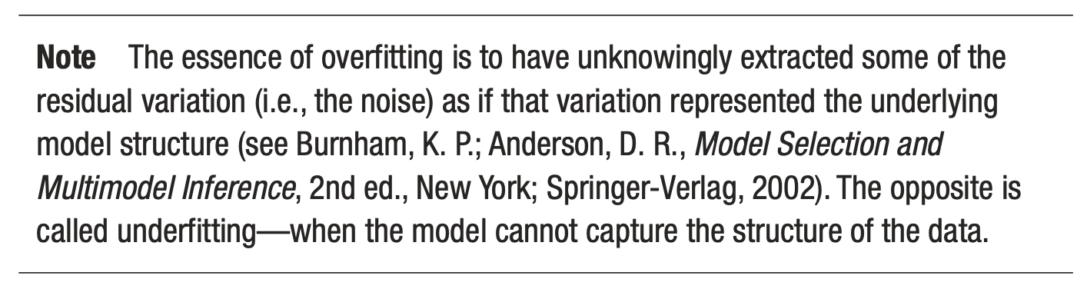
First problem - overfitting
Source:Umberto Michelucci, Applied Deep Learning - A Case-Based Approach to Understanding Deep Neural Networks, APRESS 2018
Underfitting
Just fitting ;-)
Overfitting

Slide 34
Optimizers

Slide 35
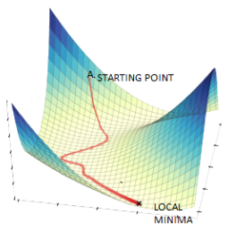
Gradient Descent
Image source: https://www.datasciencecentral.com/alternatives-to-the-gradient-descent-algorithm/, Last visited 20/8/2022

Slide 36
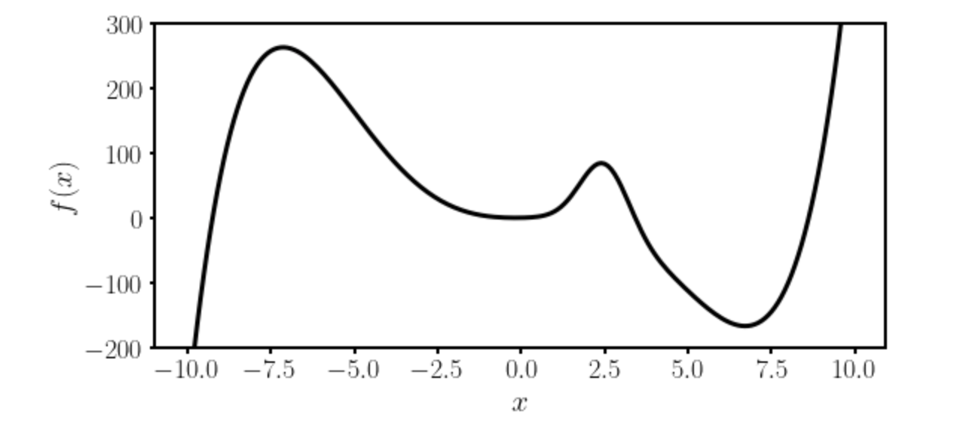
Gradient Descent I
Let’s suppose we want to find the absolute minimum of a given function $f(x)$.

Slide 37
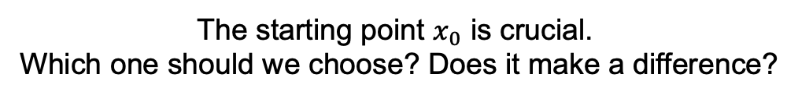
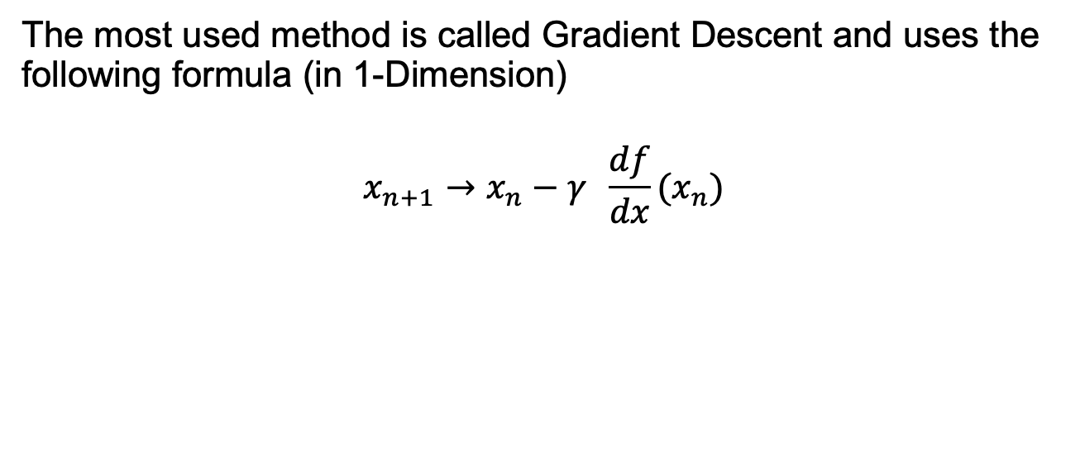
Gradient Descent II
The most used method is called Gradient Descent and uses the following formula (in 1-Dimension)
$$x_{n+1}→x_{n}−γ \frac{df}{dx}(x_{n})$$
Slope of the
function to be
minimized
New minimum location
approximation
Previous minimum location
approximation
Learning rate
The starting point $x_{0}$ is crucial.
Which one should we choose? Does it make a difference?

Slide 38
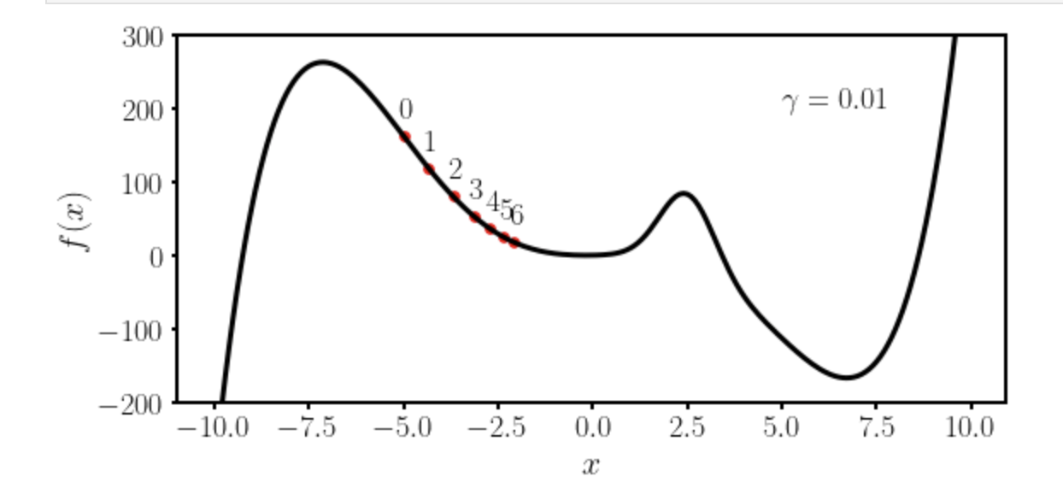
Gradient Descent III
Let’s suppose we want to find the absolute minimum of a given function $f(x)$.
We choose $x_{0}=−5$ and $γ=0.01$

Slide 39
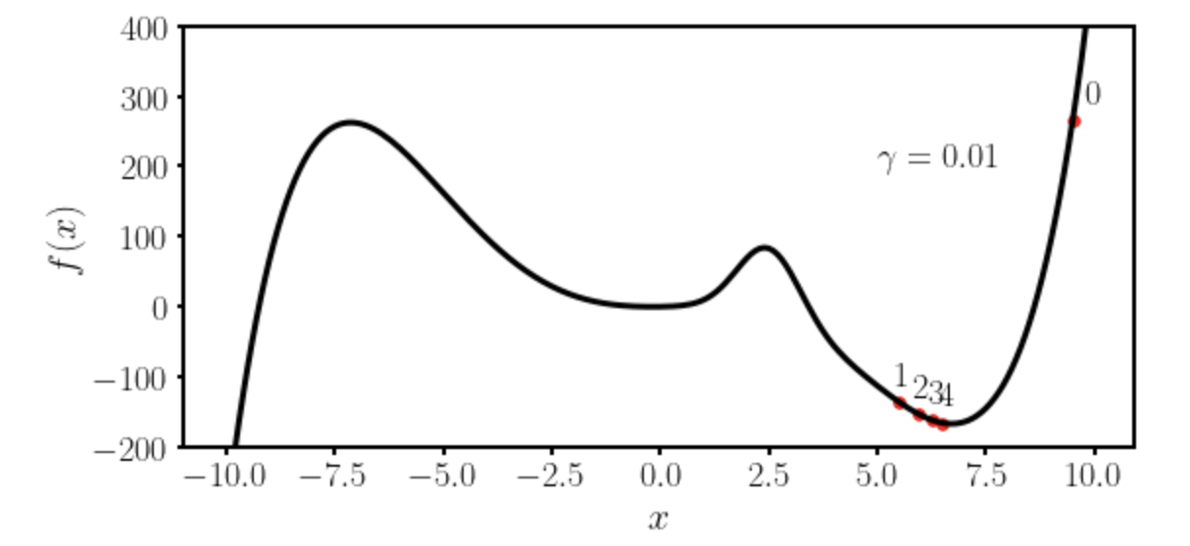
Gradient Descent IV
Let’s suppose we want to find the absolute minimum of a given function $f(x)$.
We choose $x_{0}=−9.5$ and $γ=0.01$

Slide 40
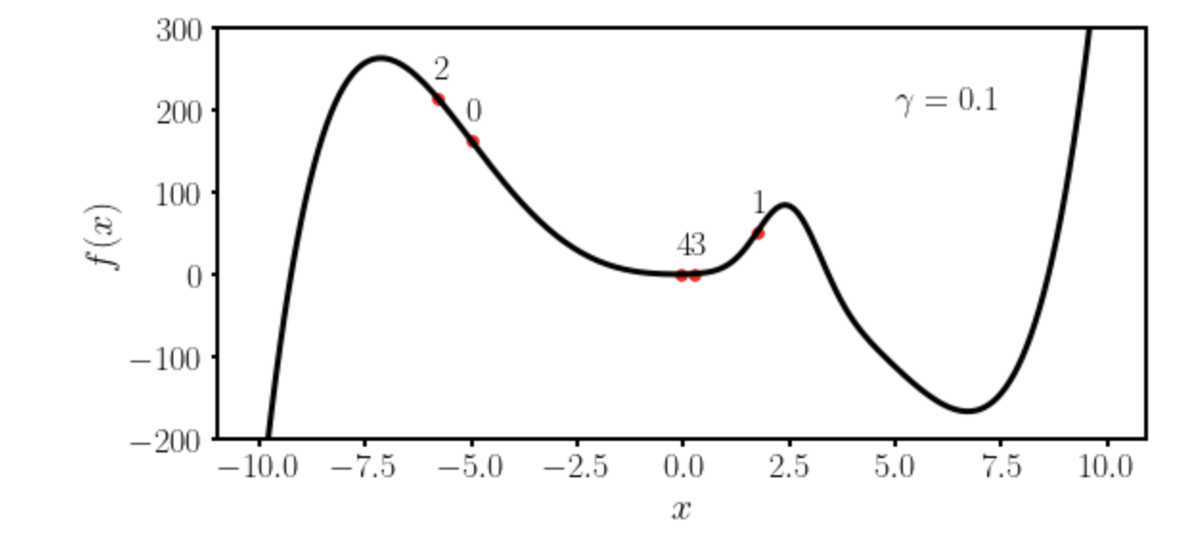
Gradient Descent V
Let’s suppose we want to find the absolute minimum of a given function $f(x)$.
We choose $x_{0}=−5$ and $γ=0.1$

Slide 41
Some remarks about gradient descent
To use gradient descent you will need the derivative (or gradient in multiple dimensions) of the function you want to minimize.
Due to this reason methods as autodifferentiations and back-propagations have been developed to be able to calculate the derivative of the network function.
→ Gradient descent is not the most efficient way of finding minima. It gets easily stuck in local minima. More advanced optimisers have been developed and are typically used.

Slide 42
First challenge: the right learning rate
https://www.benfrederickson.com/numerical-optimization/

Slide 43
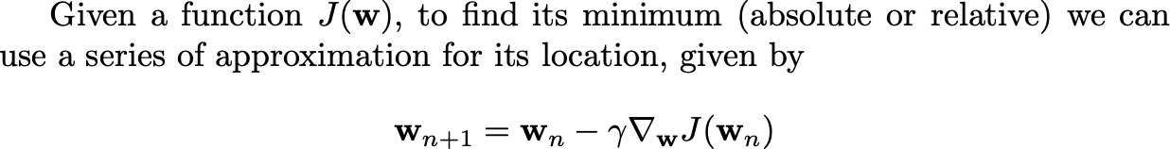
Gradient Descent
For those of you with more mathematical and programming background here is an implementation from scratch of the gradient descent: http://adl.toelt.ai/gradientDescent/Gradient_descent_developed_from_scratch.html

Slide 44
Optimizers
Gradient Descent
RMSProp
Adam
And many others…

Slide 45

Comparison of algorithms in 2D
U. Michelucci, Applied Deep Learning with TensorFlow 2, Springer Nature, 2022

Slide 46

Comparison of algorithms in 2D
U. Michelucci, Applied Deep Learning with TensorFlow 2, Springer Nature, 2022

Slide 47

Comparison of algorithms in 2D
U. Michelucci, Applied Deep Learning with TensorFlow 2, Springer Nature, 2022

Slide 48

Comparison of algorithms in 2D
Source:Umberto Michelucci, Applied Deep Learning - A Case-Based Approach to Understanding Deep Neural Networks, APRESS 2018

Slide 49
Challenges with Neural Networks

Slide 50
Gradient Descent variations
Batch - Update the weights after all observations have been evaluated
Mini-batch - Update the weights after n observations have been evaluated
Stochastic - Update the weights after each single observations have been evaluated

Slide 51


Gradient descent variations - a comparison
Source:Umberto Michelucci, Applied Deep Learning - A Case-Based Approach to Understanding Deep Neural Networks, APRESS 2018

Slide 52
Regularization

Slide 53



Regularization are techniques to reduce overfitting (let’s discuss…)
Source:Umberto Michelucci, Applied Deep Learning - A Case-Based Approach to Understanding Deep Neural Networks, APRESS 2018

Slide 54

Effect of regularization on the weights
Source:Umberto Michelucci, Applied Deep Learning - A Case-Based Approach to Understanding Deep Neural Networks, APRESS 2018

Slide 55


Effect of regularization
Without
With

Slide 56
Dropout – or how to avoid overfitting

Slide 57

A basic explanation
“During training, some number of layer outputs are randomly ignored or “dropped out.” This has the effect of making the layer look-like and be treated-like a layer with a different number of nodes and connectivity to the prior layer. In effect, each update to a layer during training is performed with a different “view” of the configured layer.” [1]
[1] https://machinelearningmastery.com/dropout-for-regularizing-deep-neural-networks/

Slide 58
Additional difficulties
Hyperparameter tuning - finding the best parameters to obtain the best values for the chosen metric
Metric analysis - detecting possible issues with the datasets
Training speed - optimizing to get the fastest training possible
Big datasets - working with amount of data that does not fit in memory anymore

Slide 59
Hands-on Session
https://playground.tensorflow.org

Slide 60
From here the only limit is your creativity!

